Slide 1
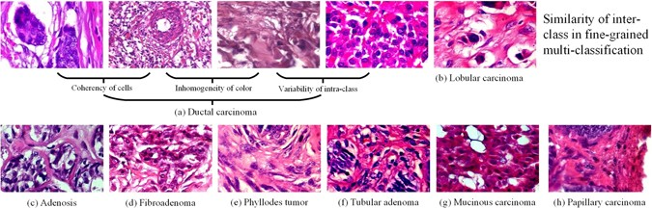
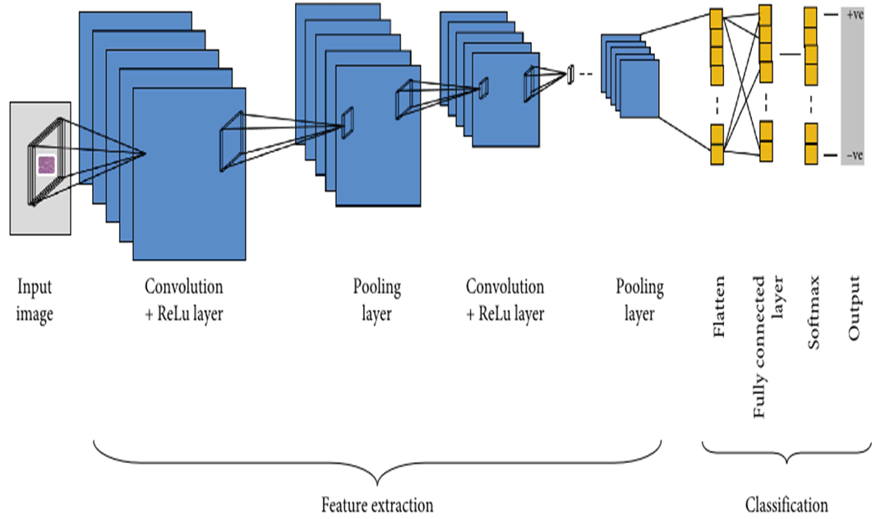

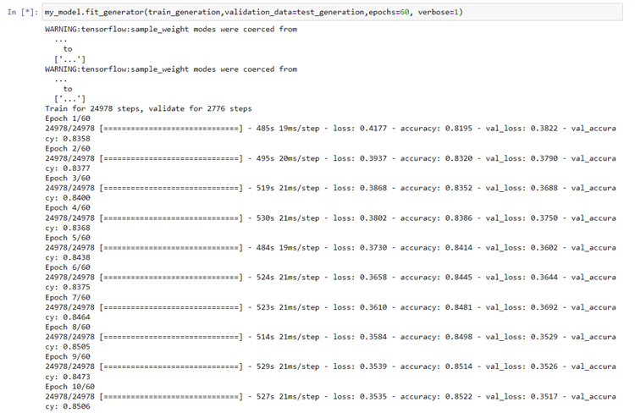
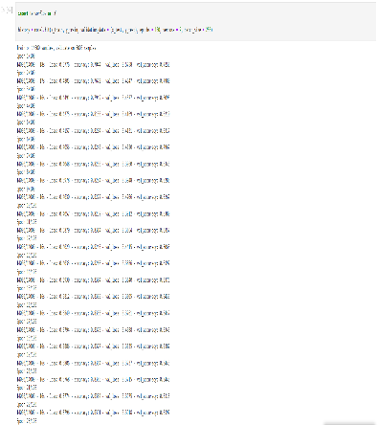
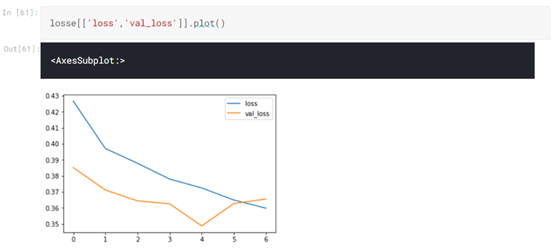
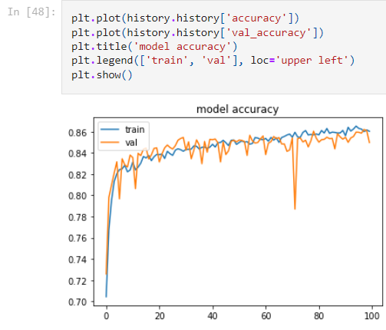
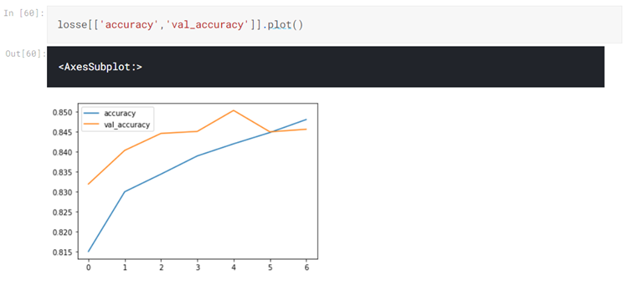
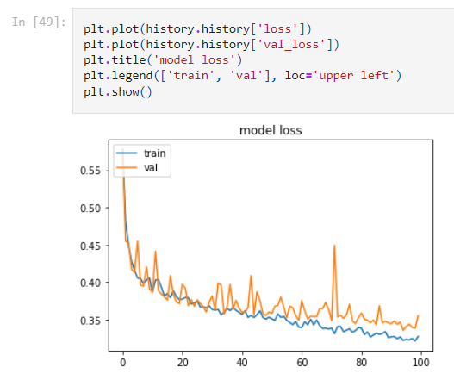
Abstract: Breast Cancer is one of the leading causes for female fatality. It has been established that the earlier a detection take place , the higher chances for a full recovery. In our research we attempt to detect whether an existing lump in the breast is a malignant or benign tumor. Using two different machine learning techniques , sequential and CNN we compare the performance of classification.
The result and conclusion: The trial employing the sequential model had the highest accuracy percentage, with an accuracy of 86 percent compared to the CNN network's accuracy of 85 percent. Despite the fact that the loss in both experiments is the same, the sequential Model is the more appropriate for this purpose. At the end The proposed algorithms has been demonstrated to successfully provide proper findings, which could eliminate human errors in the diagnostic process and lower cancer detection costs.that help in detecting breast cancer to increased efficiency and reduced pain for patients,
Dataset: we used the breast histopathology images. The dataset had two sets of images, one that had a malignant tumor and was labeled by 1, another that had benign tumor and was labeled by 0. Figure 3 shows a sample of dataset.
Experiment 1 : sequential model The task of predicting what word/letter will come next , and here, the Sequential Model begins by identifying and classifying the images through the trained and tested dataset, whether these entered images are benign or malignant, and then it starts giving me
the percentage of model
accuracy and percentage
loss of the model, so we
can find out if this
model suitable for use in
detection or not.
experiment 2 : CNN used to explore patterns in a particular figure this is accomplished by convoluting an image and searching for patterns .we training and test for the dataset using CNN started take the images randomly and classify which of them is cancerous and which is not cancerous
By : Dina,Gaith,,Sasha
Muhanned ,Malak,Tahir
Supervisor: Dr. Hend ElMohandes
The epoch specifies the number of passes or cycles made on a complete training dataset (breast histopathology) the machine learning algorithm has finalized
Loss result: and this graph shows us the result of the loss of the data that resulted from the use of the CNN which is equals 0.35
And here we do training and test the breast histopathology dataset and repeat this process 100 times to investigate the accuracy and loss result of the test
Breast cancer detection
Accuracy result: and this graph shows us the result of the accuracy and validity of the data that resulted from the use of the CNN which is equals 0.85
Accuracy result: and this graph shows us the result of the accuracy and validity of the data that resulted from the use of the sequential model which is equals 0.86
Loss result: and this graph shows us the result of the loss of the data that resulted from the use of the sequential model which is equals 0.35

